Slide 1
Predictive Analysis of Higher Education Outcomes
Exploring Enrollment Patterns and Academic Performance
Yat Chit Law

Slide 2
Agenda
01.
02.
03.
04.
DATA
EDA
ANALYSIS
MODEL

Slide 3
Introduction
The dataset aims to analyze and understand the factors influencing student enrolment, academic performance, and socio-economic background in higher education institutions. By exploring the relationships between various attributes, the goal is to identify patterns, trends, and potential areas for intervention or improvement in the educational system. Additionally, the dataset can be utilized to develop predictive models to forecast enrolment patterns, student success rates, and the impact of economic indicators on the education sector. This analysis can provide valuable insights for educational policymakers, administrators, and stakeholders to enhance educational access, equity, and quality.

Slide 4
DATA
01.

Slide 5

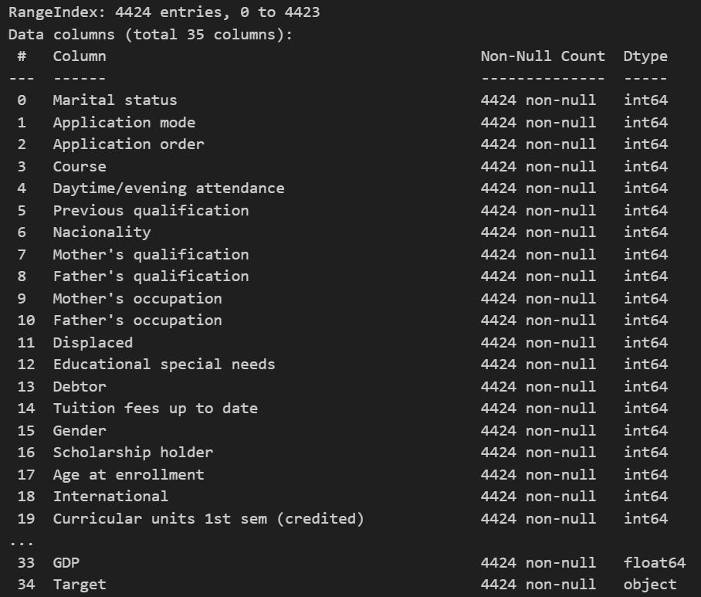
Data Understanding
Overview: 4424 rows, 35 columns.
Attributes: Marital status, course of study, previous qualifications, etc.

Slide 6
EDA
02.

Slide 7
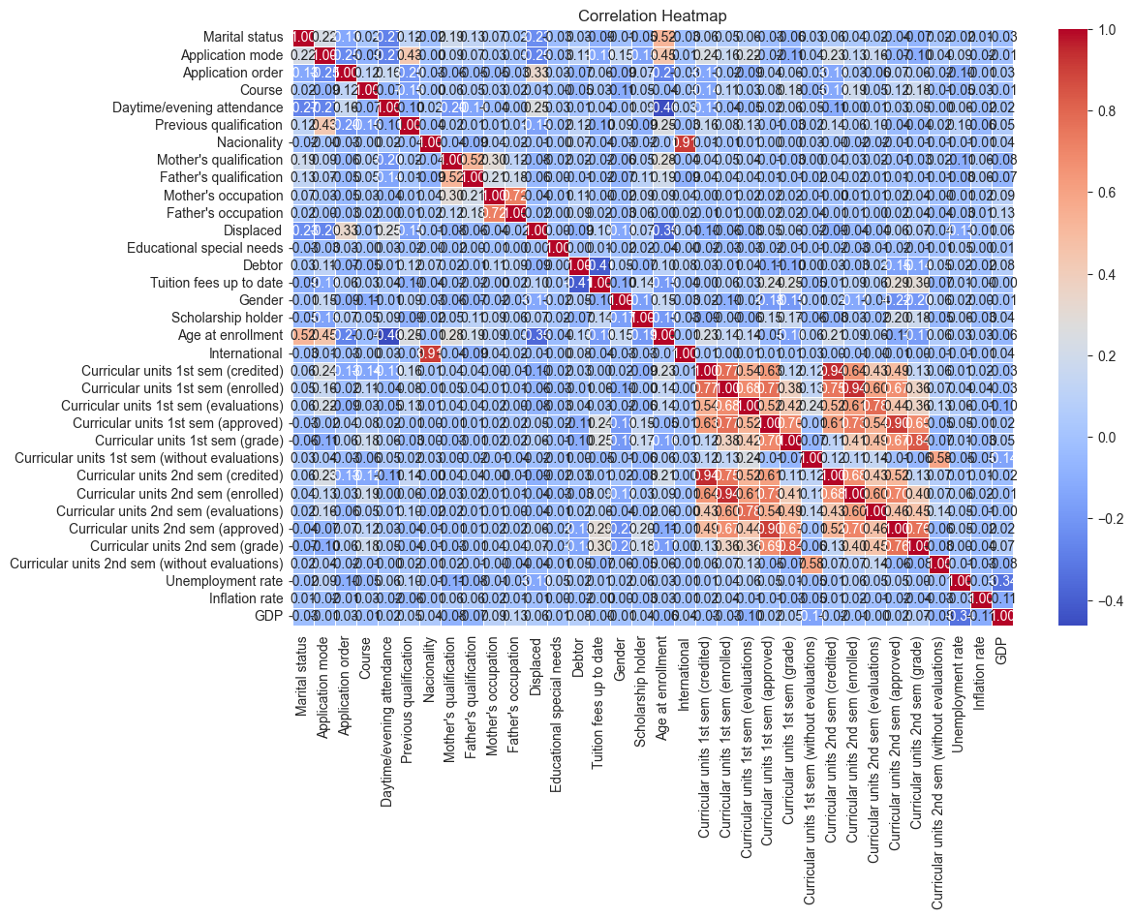
Correlation Heatmap
Insights from the Heatmap:
Curricular Units (First and Second Semesters):
Strong positive correlations between first and second semester metrics (e.g., credited, enrolled, approved units).
Suggests that students who perform well in one semester tend to maintain similar performance.
Economic Factors:
Unemployment and GDP showed weak to moderate positive correlations with the number of curricular units approved and credited.
Indicates that economic conditions might have some impact on academic performance.
Parental Occupations:
Father's and mother's occupations have a strong positive correlation, indicating that socio-economic factors affecting one parent often reflect on the other.
International vs. Nacionality:
High correlation between "International" and "Nacionality" suggests specific nationalities have a significant presence among international students.

Slide 8
ANALYSIS
03.

Slide 9
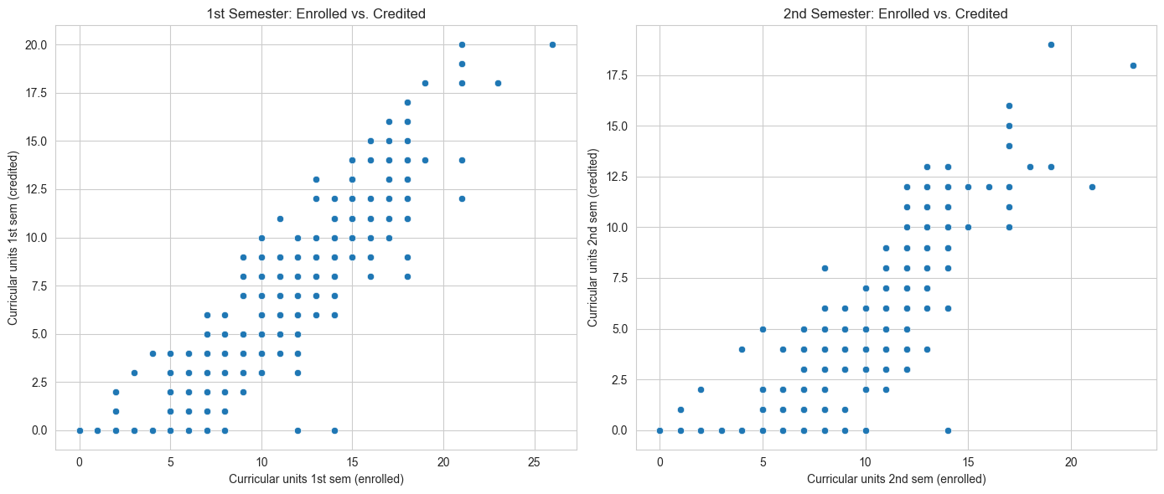
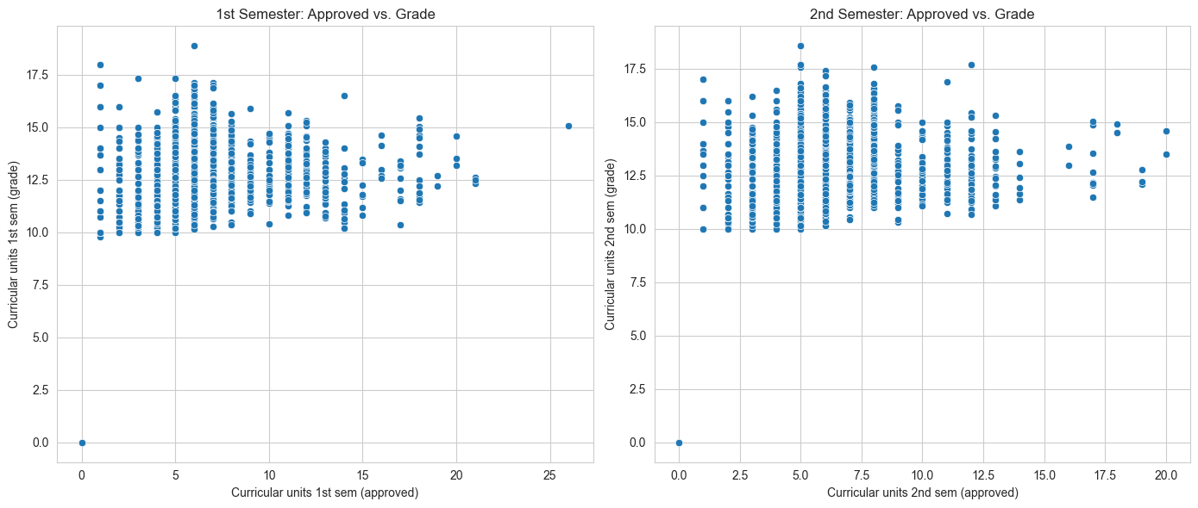
Curricular Units
Enrolled vs. Credited
Positive correlation is observed, with a trend indicating that students enrolled in more units often receive more credits.
Approved vs. Grades
Positive correlation is evident between the number of approved curricular units and grades, implying that better performance often results in more approvals.

Slide 10
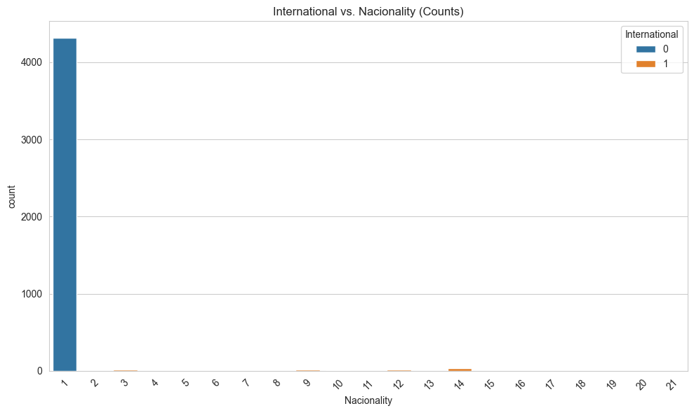

International vs. Nationality
The count plot reveals varying proportions of international students across nationalities. Some nationalities contribute significantly to international student enrollment.

Slide 11
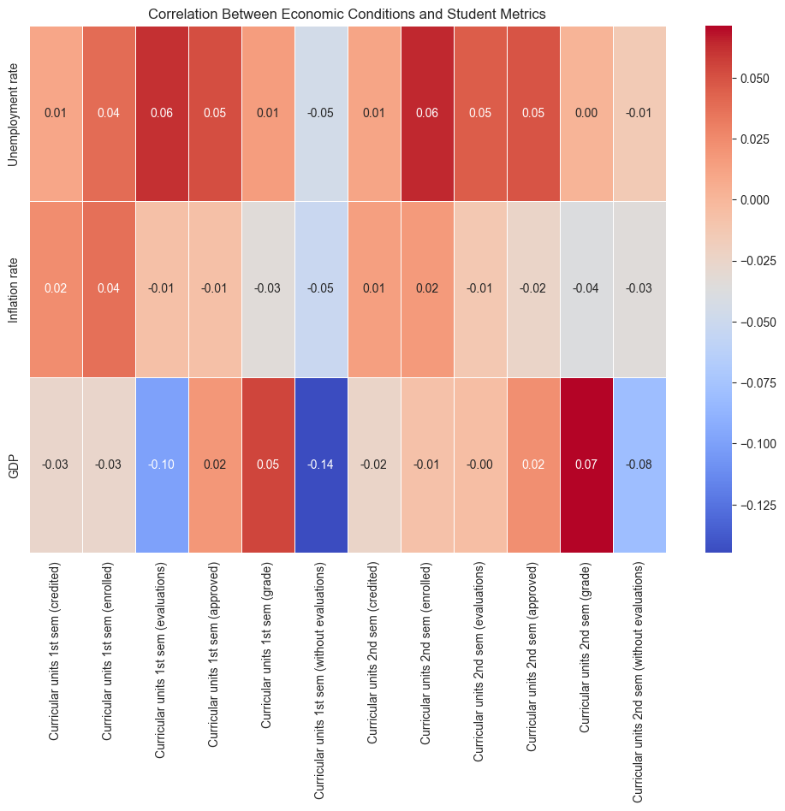
Analysis of Economic Conditions Impact
Unemployment Rate
Positively correlates with the number of enrolled units, especially in the first semester. It might indicate that economic downturns lead to higher enrollment as people seek further education.
Inflation Rate
Mostly weak correlations, but slightly positive with approved and credited units, suggesting minimal impact.
GDP
Generally has weak to moderate positive correlations with approved and credited units. Improved economic conditions might support higher approvals and credits.

Slide 12
MODEL
04.

Slide 13
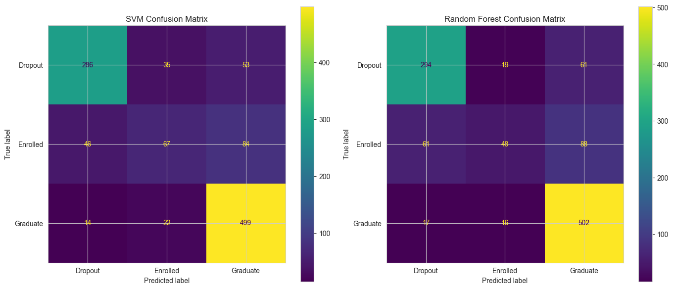
MODEL PERFORMANCE
ALGORITHM
We'll implement these visualizations using the models trained earlier, focusing on the SVM and Random Forest models for their high accuracy.
Confusion Matrix
Both matrices reveal the classification performance for each class, including 'Dropout', 'Enrolled', and 'Graduate'.
The SVM and Random Forest models correctly classify a significant number of 'Graduate' and 'Dropout' instances, while 'Enrolled' presents some misclassification.

Slide 14
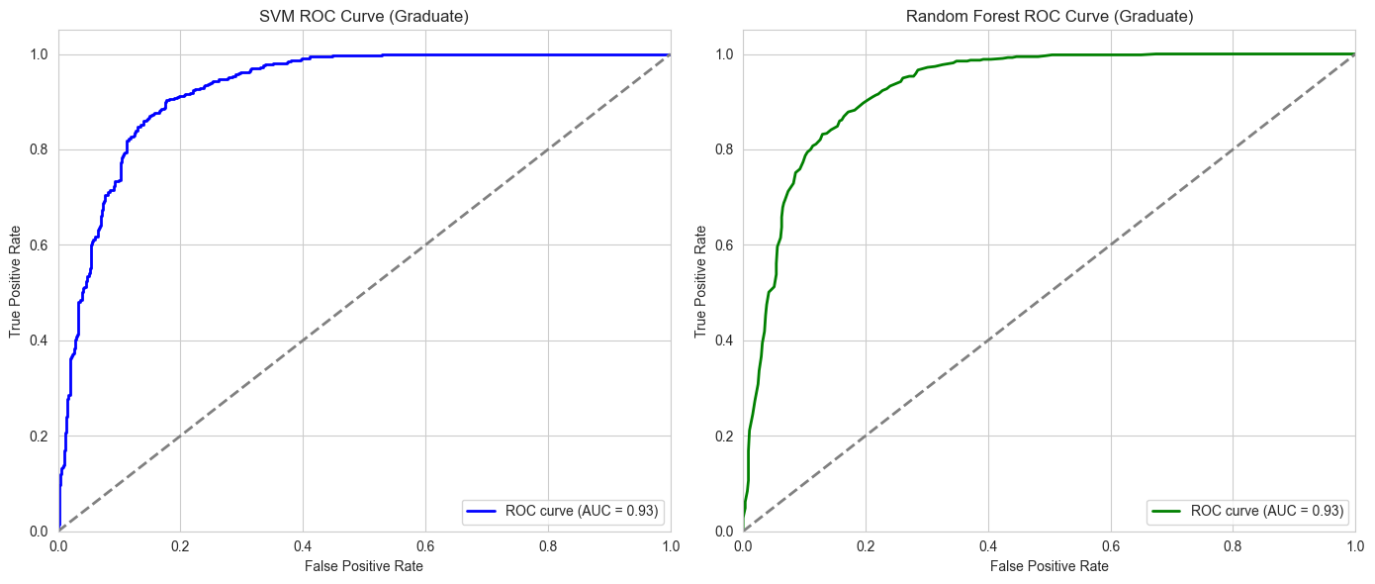
MODEL PERFORMANCE
ROC Curves
The ROC curves for 'Graduate' vs. the rest show the true positive and false positive rates.
Both models demonstrate strong discriminatory performance with AUC values well above 0.80, indicating reliable predictions.
RESULT
Both SVM and Random Forest Model are perform high accuracy on these predictive model.

Slide 15
CONCLUSION
Conclusion:
Predictive models effectively differentiate between "Dropout" and "Graduate."
Recommendations:
Implement targeted support for international students.
Use predictive modeling to identify students at risk of dropping out.
Monitor economic trends to adjust enrollment strategies.

Slide 16

Thanks!
Do you have any questions?
101488845@georgebrown.ca

